Slide 1
How to use this deck
This deck includes recorded audio (in English). You may play the deck and view it as a video by
Making sure Play Narrations is Checked
pressing F5 or Playing the Slideshow.
Note: If you only want to view the slideshow, without the narrations, uncheck “Play Narrations”

Slide 2
Walkthrough for Onboarding for Code Signing and Updates

Slide 3
Pre Requisites
Before you can onboard with Windows Phone Code Signing and Update Services, you need to:
Register as an OEM on the Windows Phone OEM Portal at http://dev.windowsphone.com/oem
Have signed the Commercialization Agreement

Slide 4
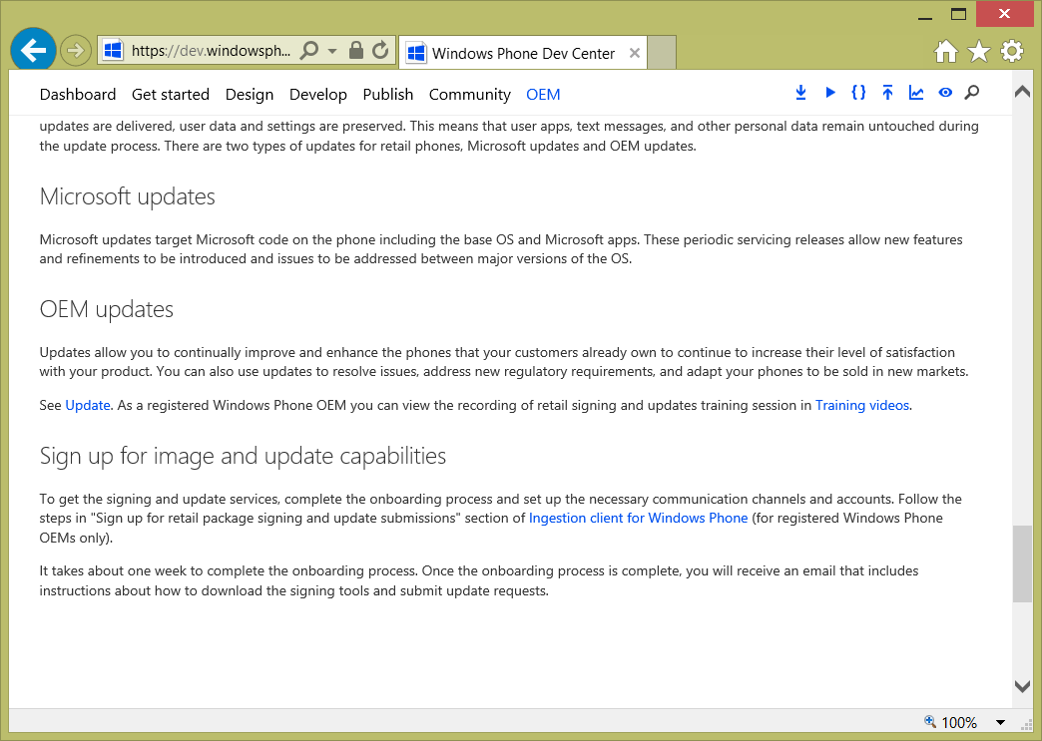
Getting the Forms
You can start at the Windows Phone OEM Portal, on the Operate Page. At the bottom is a section for “Sign up for image and update capabilities”.
Read this, and then click the link for
Ingestion client for Windows Phone
The Ingestion Client is the tool you will use to submit packages for signing, download signed packages, and request updates.

Slide 5
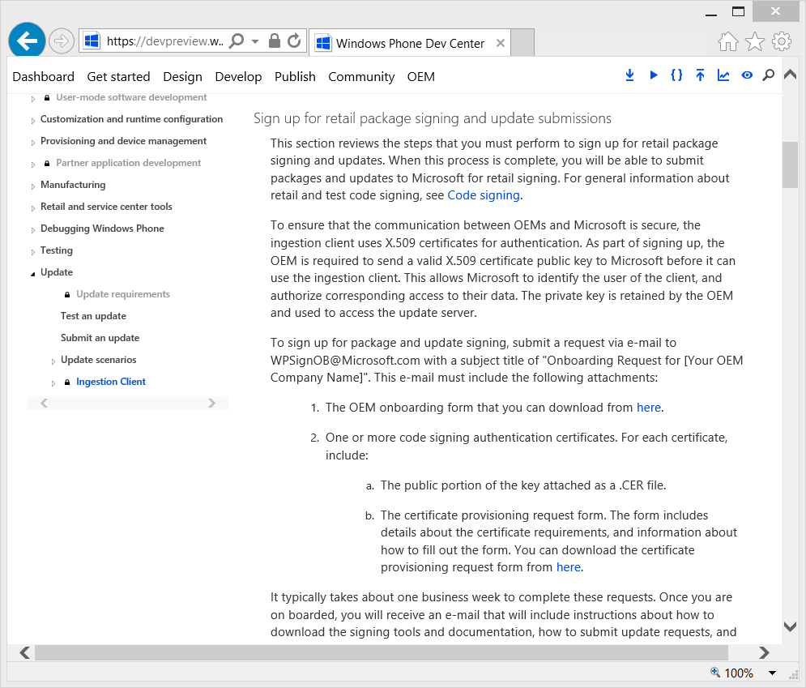
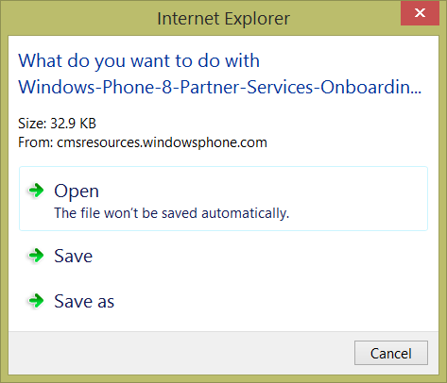
Getting the Forms
Scroll down to the section “Sign up for retail package signing and update submissions”.
Read this whole section.
Then download the two forms:
OEM Onboarding Request Form
Certificate Provisioning Request Form

Slide 6
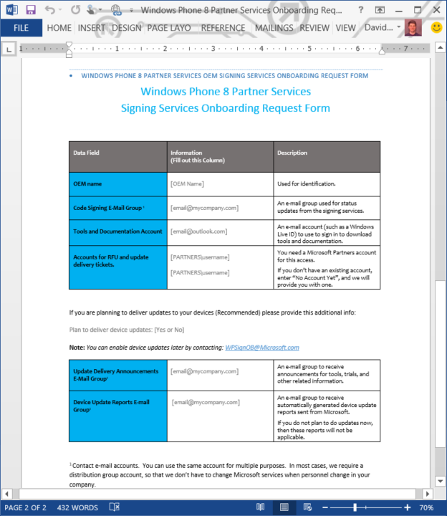
Onboarding Request Form
The first form to fill out is the Onboarding Request Form. Most of this information is to set up communication channels.
For most of them, use e-mail groups that your company owns. This makes it very easy for you to add or remove people without needing to contact Microsoft. We will reject a submission that does not use an e-mail group where specified.
If you already have a connect account, please enter the e-mail address for that account. If not, enter the e-mail address you want to use to access and download the Ingestion Client.
If you already have a PARTNERS account (most companies do not), enter that. If you don’t, then enter the e-mail address of the person you wish to get primary access and can manage additional users from your company to have access.
When you have filled out all the boxes, save this document.

Slide 7
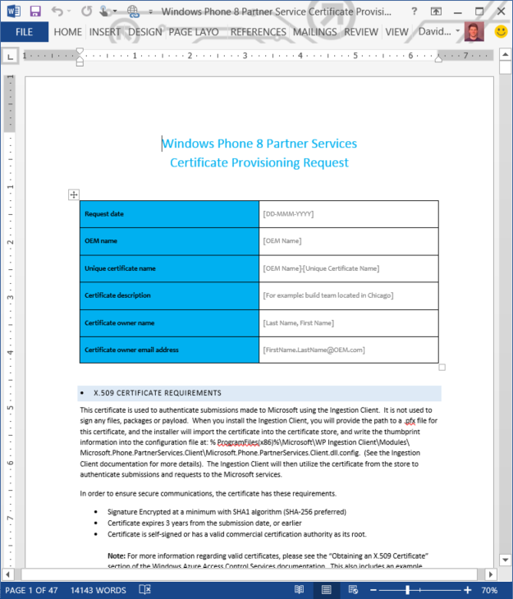
Certificate Provisioning Request Form
The next form to fill out is the Certificate Provisioning Request Form. The next few slides will talk about creating the certificates, you can fill out the form now.
Fill out your company name.
Also, fill out a unique certificate name. If you have multiple geographic build locations, you may want to provision more than one certificate. Giving each a unique name and description makes it easier to identify the certificate in the future when you want to update or remove a certificate.
We also need a single person (not an e-mail group) for the certificate owner and their e-mail. That way, we know who to contact if there’s a problem or security issue.
This form also has lots of great additional information, such as what the minimum certificate requirements are, how to send them to Microsoft, and also included is a Whitepaper on a technique you can use to secure your certificate.
If you like, you can trim out everything in the doc starting with “X.509 Certificate Requirements” to make the doc you transmit to Microsoft smaller. If you do, save the original form in a safe place so you can refer to it later.

Slide 8
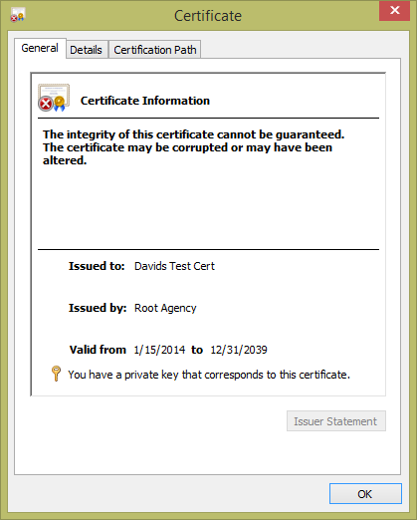
Certificates
First, let’s discuss what this certificate is used for and what it is not.
This X.509 certificate is used to identify your requests made through the Ingestion Client. Because the Ingestion Client is designed to be scriptable, so it can be integrated into automated systems, we use a certificate to authenticate rather than a login, like a Microsoft Account. That way, your systems don’t have to stop and wait for someone to enter a password.
The certificate is NOT used to sign any files or packages.
This certificate has nothing to do with OVK, it, and the Ingestion Client and Code Signing and Update Services are separate from that system.

Slide 9
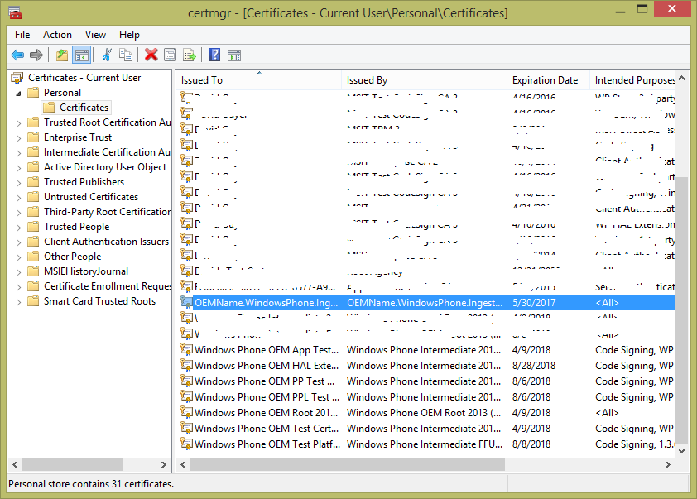
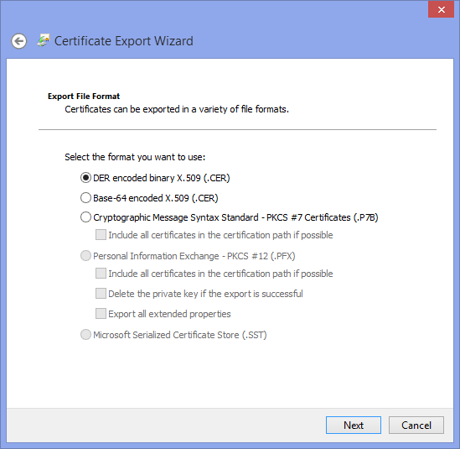
Creating a Self Signed Certificate
The Certificate Provisioning Request Form will be updated with the latest requirements, so be sure to refer to that when creating a certificate.
At the time of creating this walkthrough, certificates needed to
expire within 3 years ( -e )
Be self signed ( -r ) or be provided by a Commercial and Public Certificate Authority. The latter is more secure and preferred. We’ll show the self-signed example in this walkthrough because it is the easiest.
And use the Sha1 algorithm at a minimum, though Sha256 is preferred.
You may need to get the Windows SDK to get a copy of MakeCert.exe if you plan to Use this sample command line to create a certificate. You can also find documentation on makecert.exe online at http://MSDN.Microsoft.com , then search for MakeCert.Exe
In this example, the certificate will be created in your machine’s certificate store. You can then export only the public key, and use the certificate in the store with the Ingestion Client. As a result, you should create the certificate on your build machine.
The certificate name “CN” in this example is a recommendation, you can enter what you want, but having your company name is a best practice.
Set the date for the –e parameter to a date 3 years from today, or earlier.
If you need to move the certificate, you can export it to a password protected .PFX file and import it on another machine, which we will not illustrate in this walkthrough.
Then, you can export the public key. Instructions for this are provided in the Certificate Provisioning Request form.
You open certmgr.msc and find your new certificate.
Then, you right click on it, select All Tasks, and Export
Then you export only the public key in a DER format.
The .cer file you create you will send to Microsoft.
makecert.exe –r –pe –n “CN=OEMName.WindowsPhone.IngestionClient” –sky exchange –ss my –len 2048 –e 5/30/2017 –a sha256

Slide 10
Keeping Certificates Secure
This is important: Keeping the private key of your certificate secure is your responsibility. Regardless of any advice provided in our documentation or this walkthrough.
Read the Certificate Provisioning Request Form for more info and examples of how to keep it secure.
Treat it as one of your company secrets
Only allow access by those people and systems that need it.
Keeping it in a cert store, rather than in a file somewhere, is usually more secure.
If you suspect a certificate is compromised, please work with Microsoft to disable the compromised cert and onboard a new one immediately.

Slide 11
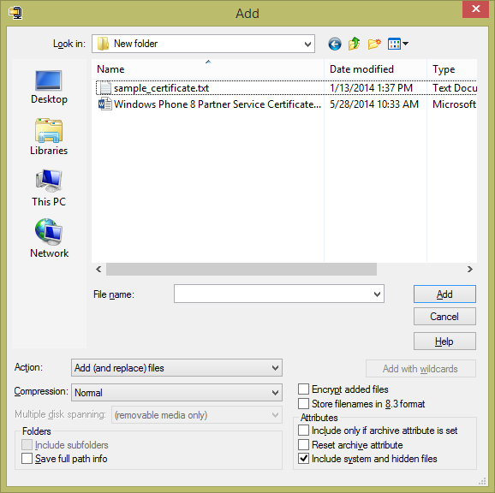
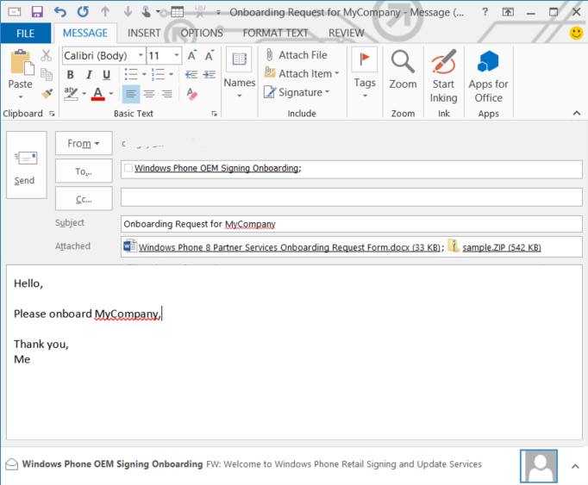
Sending the Onboarding Request Packet to Microsoft
To send your Onboarding Request Packet to Microsoft, please follow these steps:
Rename the .cer file as a .txt file. This is important to get through corporate e-mail servers, and sometimes takes more than one try.
Place the completed form and .txt file in a .zip file
Attach this zip file to your onboarding request e-mail.
Put “Onboarding Request for-” in the e-mail subject, and add your company name.
Also attach the Onboarding Request Form
Send this mail to WPSignOb@Microsoft.com
Rename myCert.cer myCert.txt

Slide 12
Next Steps
Microsoft will review your submission and if there are any issues will reply with the set of issues to resolve.
Once you have a validated submission, Microsoft will respond with an estimated onboarding date.

Slide 13
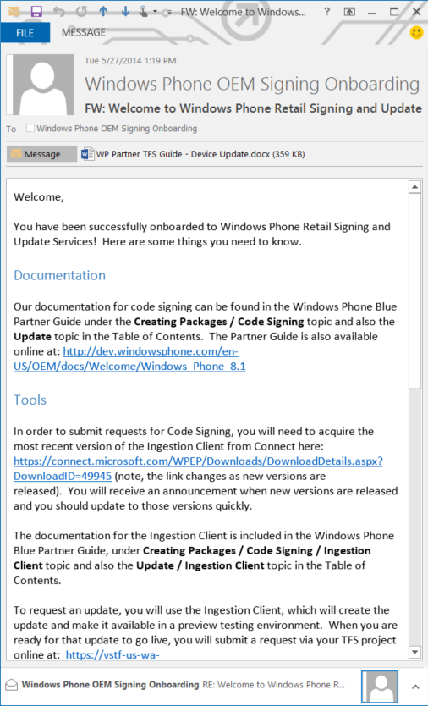
Welcome Mail
When onboarding is complete, you will receive a welcome mail with the next steps. This will include:
How to download the Ingestion Client
Any accounts you need to activate.
How to access additional services.
Pointers to documentation.
How to request support
Read and share this information with your team, and follow the instructions.
Then, start working on signing your retail images and testing updates!

Slide 14
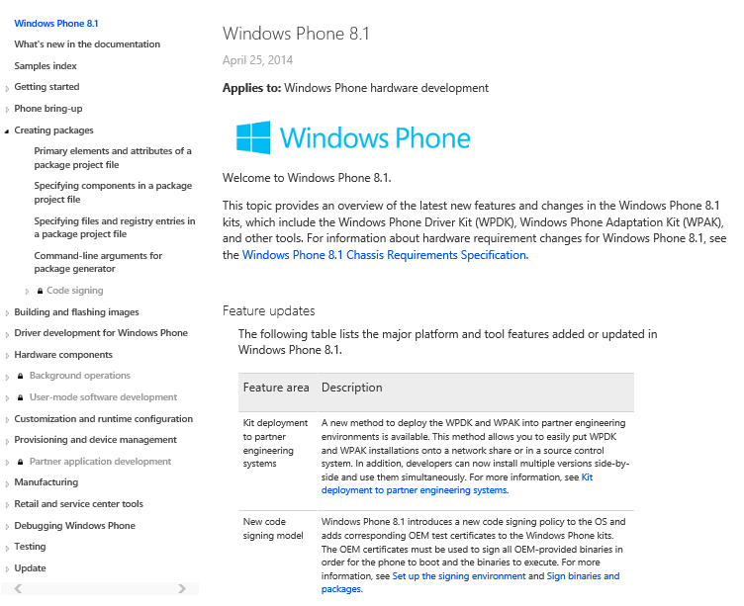
Documentation
Documentation is available as .CHM files from Connect, or online on the WP OEM Portal at
https://dev.windowsphone.com/en-US/OEM/docs/Welcome/Windows_Phone_8.1
Our documentation for code signing can be found in the Windows Phone Blue Partner Guide under the
Creating Packages > Code Signing topic and also the
Update topic
in the Table of Contents
Documentation is your FIRST LINE of SUPPORT

Slide 15
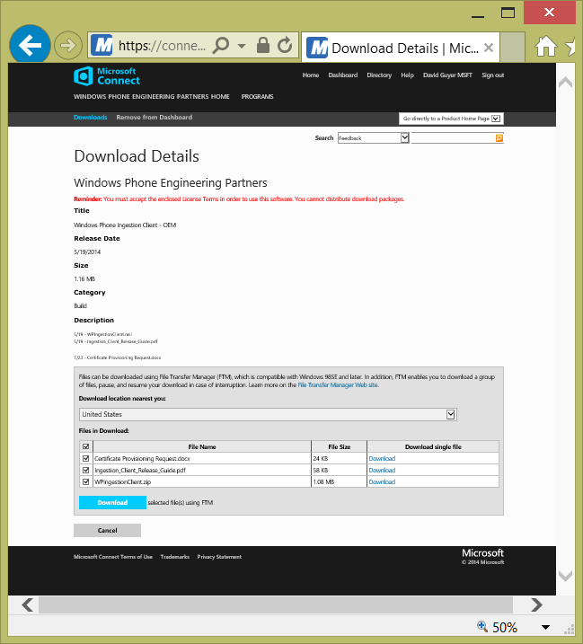
Getting the Ingestion Client
You will download the Ingestion Client from Connect, and follow the instructions to install the client from the documentation:
https://dev.windowsphone.com/en-us/OEM/docs/Update/Ingestion_Client_for_Windows_Phone
Once you are onboarded, you will get occasional e-mails about every 2 months informing you of updates to the Ingestion Client. You should get these updates quickly.

Slide 16
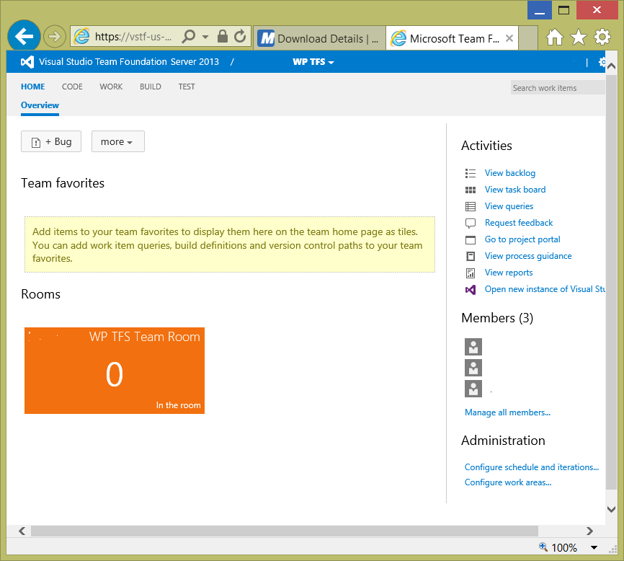
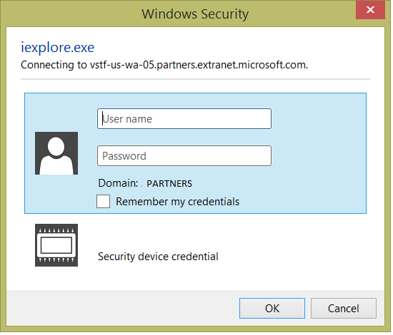
Logging into TFS
You will want to log into TFS to make sure this is working.
Once Logged in, you can create new Bugs. Refer to the TFS User Guide that is included in your Welcome Mail for details of what bug type to create and how to fill it out correctly.
You will use TFS to:
Submit requests for FFU Catalog Signing (temporary)
Approve Updates to go Live to Customers

Slide 17
Getting Support
Your first resource for support is to read the documentation. Either download the Windows Phone Blue Partner Guide from connect, or read it online at: http://dev.windowsphone.com/en-US/OEM/docs/Welcome/Windows_Phone_8.1
If you cannot find the answer to your question in the docs, then:
Log a support bug in Qualcomm’s system that you should already be using. Qualcomm will help or will route the bug to Microsoft for support. Use the Code Signing category for issues related to retail signing and delivering updates. Use the Updates category for issues with the update system on the device.

Slide 18
End of Walkthrough

